Slide 1








: a Lightweight Simulator for Large-Scale DNN Workloads on Multi-GPU Systems
TrioSim
Ying Li¹, Yuhui Bao^{2,3}, Gongyu Wang³, Xinxin Mei⁴, Pranav Vaid^{3,5}, Anandaroop Ghosh³,
Adwait Jog⁶, Darius Bunandar³, Ajay Joshi^{3,7} and Yifan Sun¹
¹ William & Mary ² Northeastern University ³ Lightmatter ⁴ Jefferson Lab
⁵ Stanford University ⁶ University of Virginia ⁷ Boston University

Slide 2
: a Lightweight Simulator for Large-Scale DNN Workloads on Multi-GPU Systems
TrioSim
Ying Li¹, Yuhui Bao^{2,3}, Gongyu Wang³, Xinxin Mei⁴, Pranav Vaid^{3,5}, Anandaroop Ghosh³,
Adwait Jog⁶, Darius Bunandar³, Ajay Joshi^{3,7} and Yifan Sun¹
¹ William & Mary ² Northeastern University ³ Lightmatter ⁴ Jefferson Lab
⁵ Stanford University ⁶ University of Virginia ⁷ Boston University

Slide 3
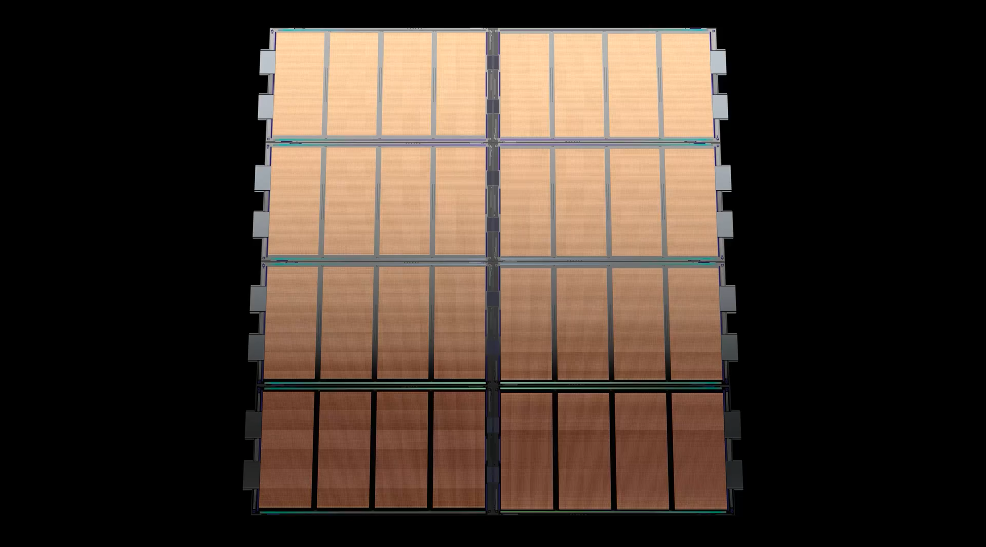

Light
Lightmatter
PASSAGE
https://lightmatter.co/products/passage/

Slide 4
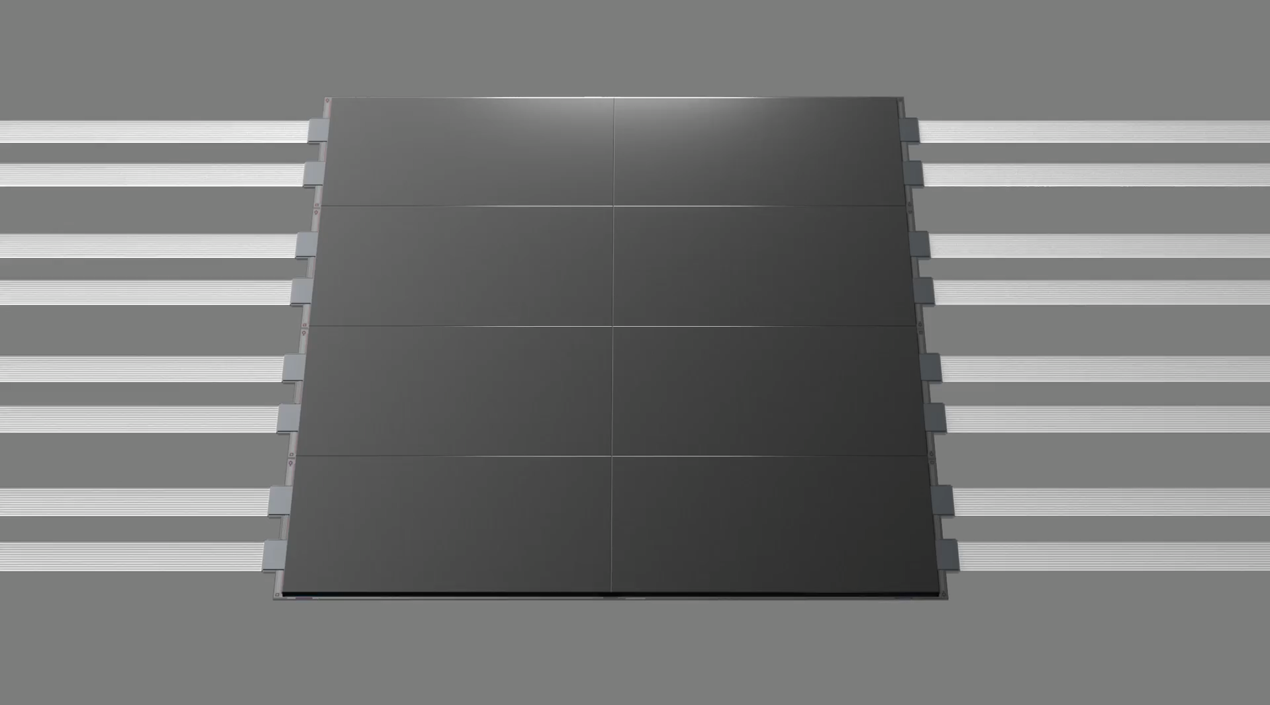
Lightmatter
PASSAGE
https://lightmatter.co/products/passage/

Slide 5
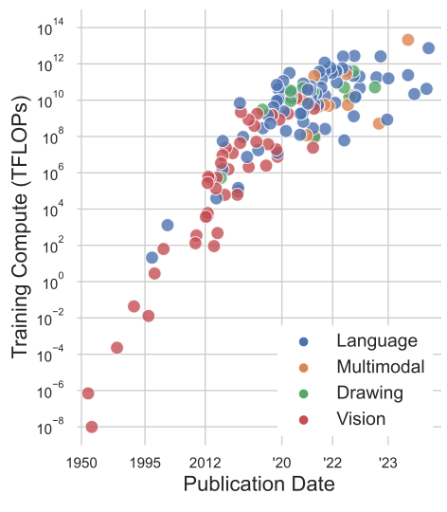
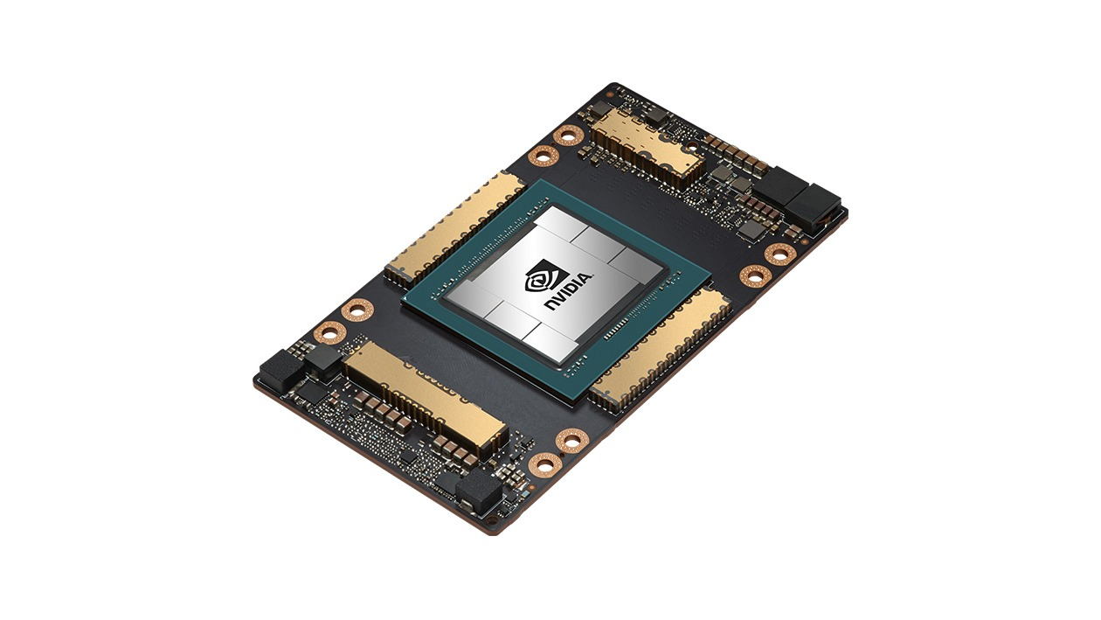


Motivation
GPT-4 network
25000 A100 GPUs
90-100 days
Large Workload
https://medium.com/@daniellefranca96/gpt4-all-details-leaked-48fa20f9a4a

Slide 6
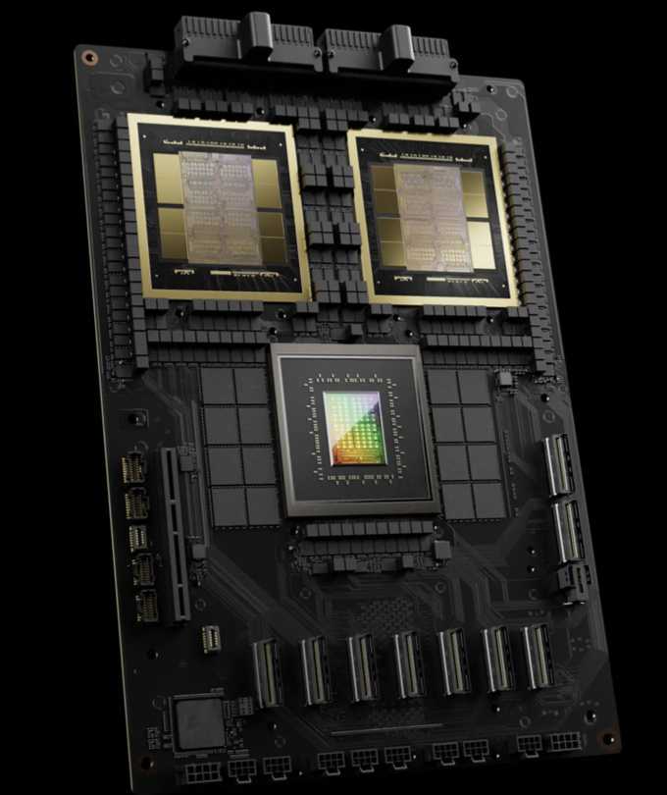
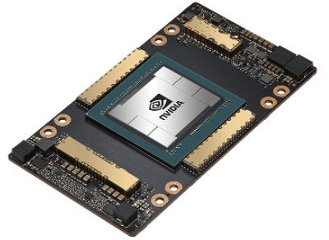
Motivation
Large Workload
GB200 – 1 Grace CPUs, 2 Blackwell GPUs
= 5 A100 GPUs

Slide 7
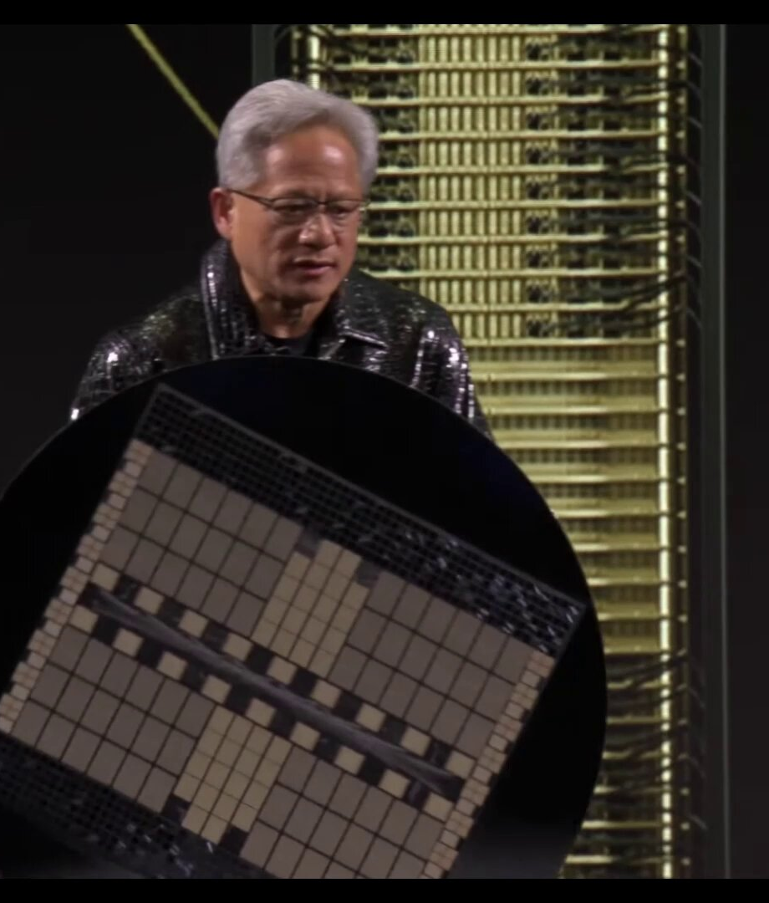
Large Workload
GB200 – 1 Grace CPUs, 2 Blackwell GPUs
NVL 72 – 36 Grace CPUs, 72 Blackwell GPUs

Slide 8
Large Workload
GB200 – 1 Grace CPUs, 2 Blackwell GPUs
NVL 72 – 36 Grace CPUs, 72 Blackwell GPUs
Large Compute, Large Memory, Large Communication

Slide 9
Large Workload
GB200 – 1 Grace CPUs, 2 Blackwell GPUs
NVL 72 – 36 Grace CPUs, 72 Blackwell GPUs
Large Compute, Large Memory, Large Communication
Simulators

Slide 10



GPU Simulators
GPUSim
NVIDIA. (n.d.). GPU-Powered Simulation & Modeling. Retrieved from https://www.nvidia.com/en-us/high-performance-computing/simulation-and-modeling/"

Slide 11
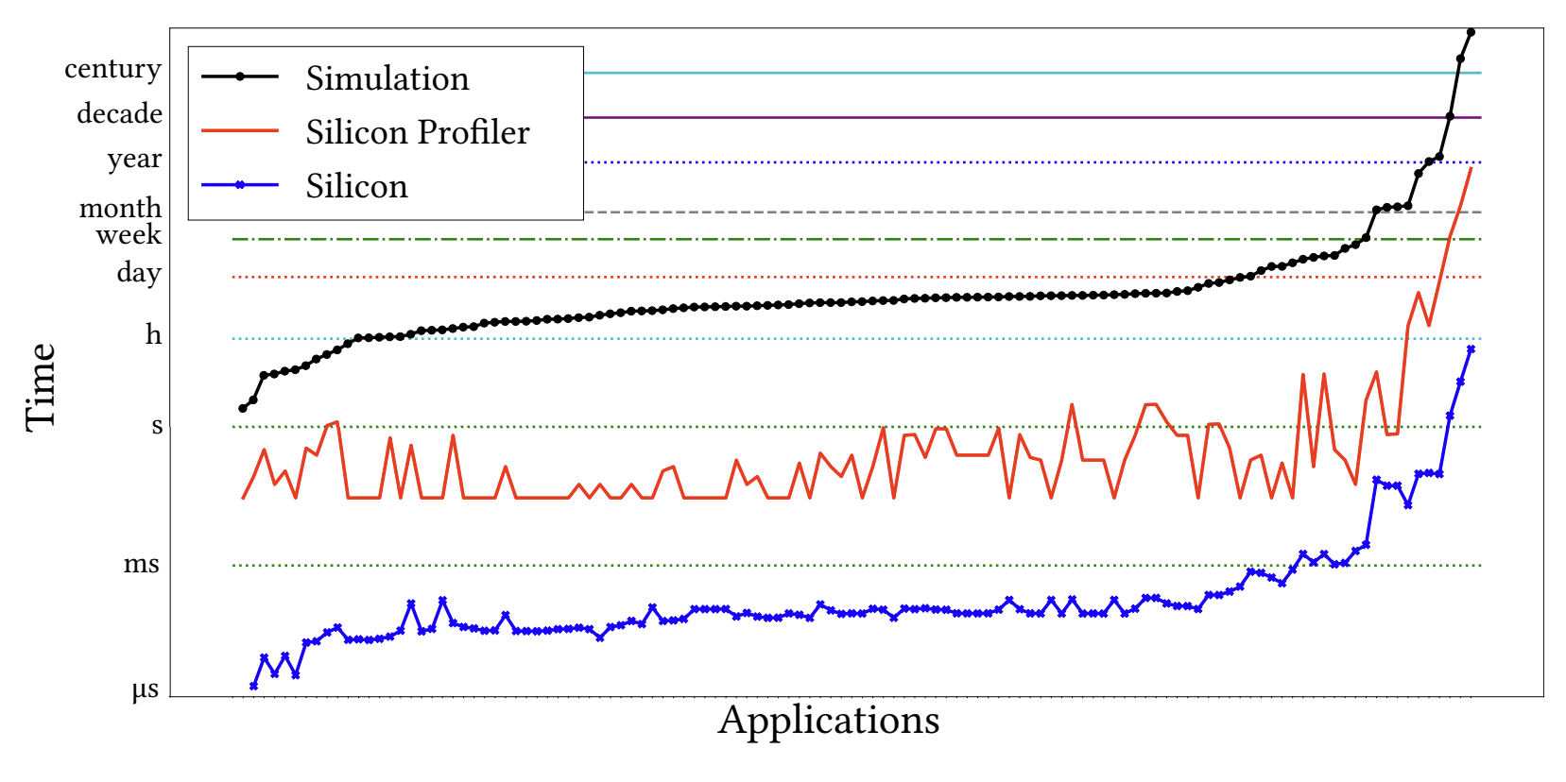
Simulation Performance
10⁶X - 10⁸X slower
1 second execution
10 days – 2 years
Simulation details
Gate-level
Cycle-level
Instruction-level
Simulation
Simulation
GPU time
GPU time
Avalos Baddouh, Cesar, Mahmoud Khairy, Roland N. Green, Mathias Payer, and Timothy G. Rogers. "Principal kernel analysis: A tractable methodology to simulate scaled gpu workloads." In MICRO-54: 54th Annual IEEE/ACM International Symposium on Microarchitecture, pp. 724-737. 2021.

Slide 12
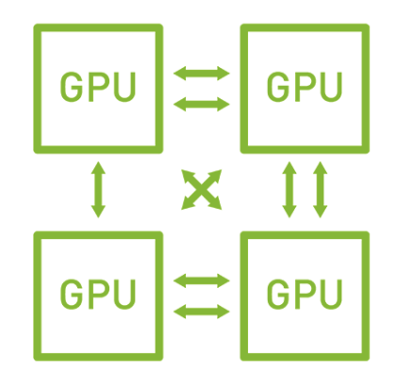
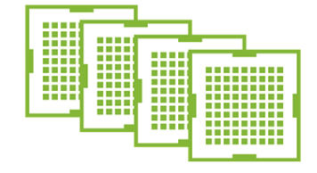

Solutions
Simulate at a higher level of abstraction.
Operator-level traces from single GPU to simulate multiple GPUs execution.
TrioSim: Simulator for Large-Scale DNN Workloads on Multi-GPU Systems
https://www.nvidia.com/en-us/design-visualization/solutions/multi-virtual-gpus/

Slide 13
The Design of TrioSim

Slide 14


The Design of TrioSim

Slide 15

The Design of TrioSim
Akita
github.com/sarchlab/akita

Slide 16
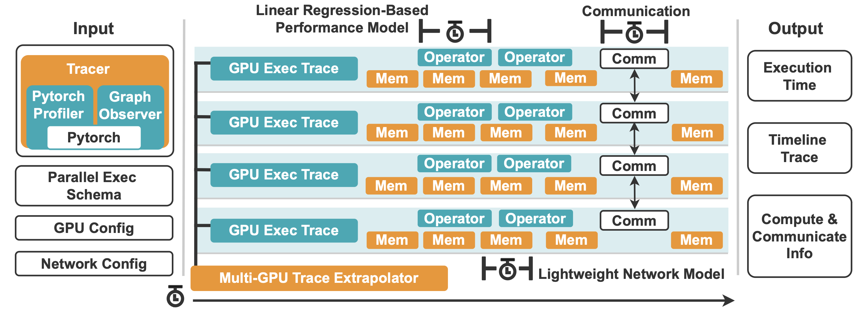
TrioSim

Slide 17
TrioSim

Slide 18
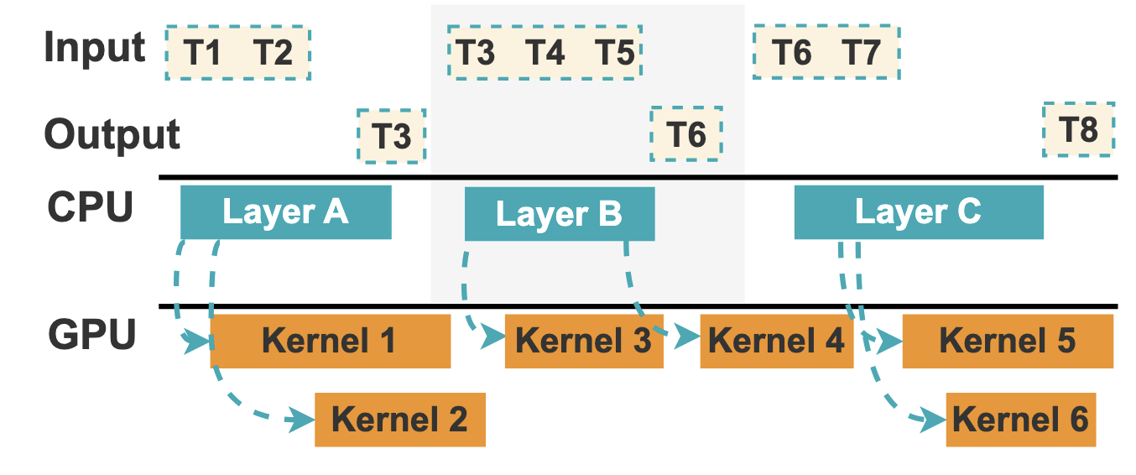
TrioSim

Slide 19
TrioSim

Slide 20
TrioSim
Trace Extrapolator
Training parallelism
Network structure
Communication pattern

Slide 21
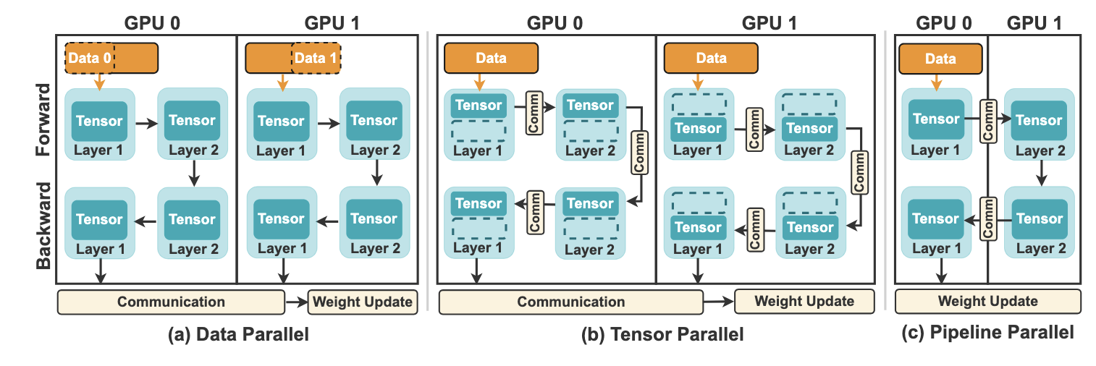
TrioSim
Trace Extrapolator
Training parallelism
Network structure
Communication pattern

Slide 22
TrioSim
Trace Extrapolator
Training parallelism
Network structure
Communication pattern

Slide 23
TrioSim
Trace Extrapolator
Training parallelism
Network structure
Communication pattern

Slide 24
TrioSim
Trace Extrapolator
Training parallelism
Network structure
Communication pattern

Slide 25
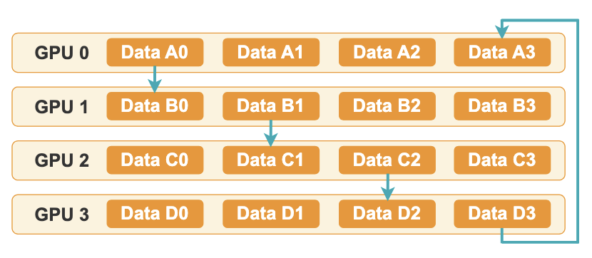
TrioSim
Trace Extrapolator
Training parallelism
Network structure
Communication pattern

Slide 26
TrioSim

Slide 27
TrioSim

Slide 28
TrioSim

Slide 29
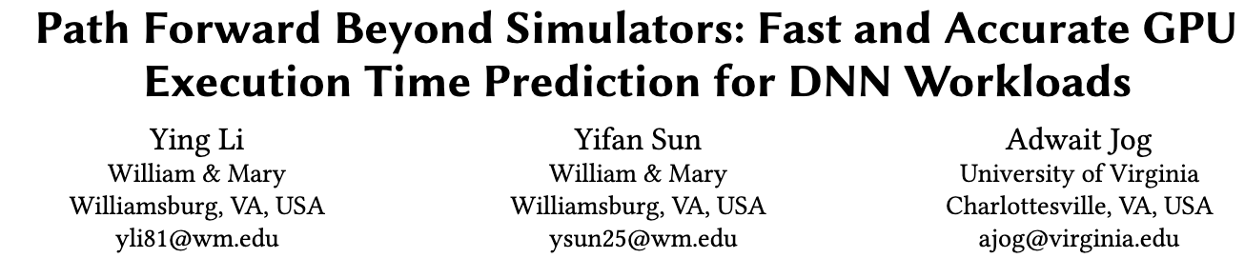
MICRO 2023

Slide 30
MICRO 2023
Layer or kernel execution times are generally linearly correlated to their Floating Point Operations.

Slide 31
TrioSim

Slide 32
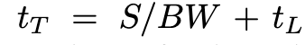
TrioSim
GPU
1. Bandwidth 2. Latency
Total Transfer Time = Data Size/ Link Bandwidth + Link Latency
GPU
GPU
GPU

Slide 33
TrioSim
GPU
1. Bandwidth 2. Latency
Total Transfer Time = Data Size/ Link Bandwidth + Link Latency
GPU
GPU
GPU
Add-on to the base model
Link sharing
Routing
End-to-end back-pressure

Slide 34
TrioSim

Slide 35
TrioSim

Slide 36
TrioSim

Slide 37
The Validation of TrioSim

Slide 38
Validation Experiment
Hardware.
P1: 2 NVIDIA A40 GPUs, connected with PCIe.
P2: 4 NVIDIA A100 GPUs, connected with NVLinks.
P3: 8 NVIDIA H100 GPUs, connected with NVLinks.
Software.
CUDA 12.1
Torch 2.1.0+cu121
Torchvision 0.16.0+cu121
Torchaudio 2.1.0+cu121

Slide 39
Validation Experiment
Hardware.
P1: 2 NVIDIA A40 GPUs, connected with PCIe.
P2: 4 NVIDIA A100 GPUs, connected with NVLinks.
P3: 8 NVIDIA H100 GPUs, connected with NVLinks.
Software.
CUDA 12.1
Torch 2.1.0+cu121
Torchvision 0.16.0+cu121
Torchaudio 2.1.0+cu121
Workloads.
Image Classification: DenseNet, ResNet, VGG.
NLP: GPT-2, BERT-Base-Uncased, T5-Small, FLAN-T5-Small, and Llama.
Parallelism strategy.
Data parallelism, tensor parallelism, pipeline parallelism

Slide 40
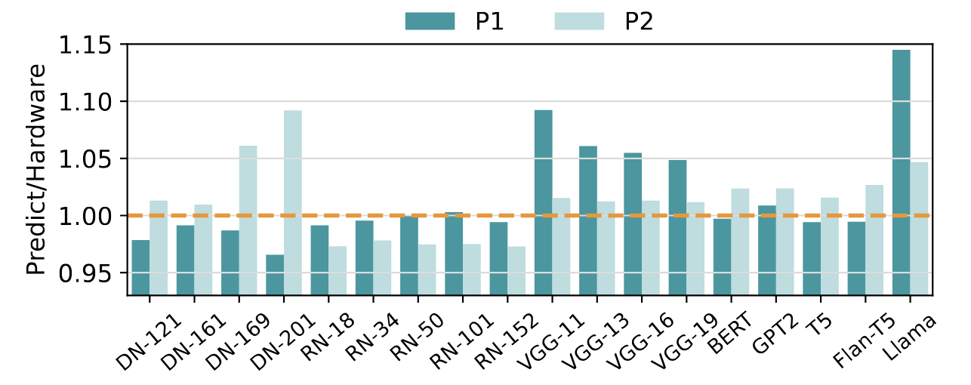
Validation Experiment
Data parallelism
Prediction errors comparing using TrioSim with applying distributed data parallelism on P1 and P2.
The average errors of the experiment set for P1 and P2 are 2.91% and 2.73%.

Slide 41
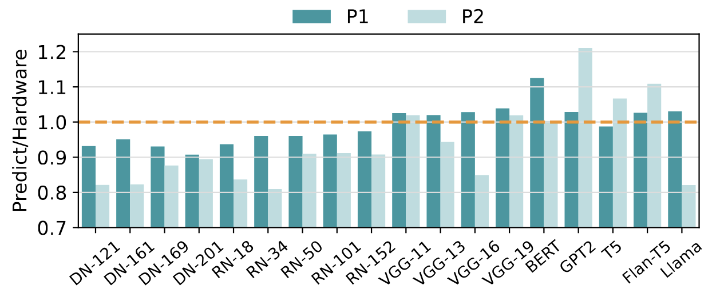
Validation Experiment
Tensor parallelism
Prediction errors comparing using TrioSim with applying Tensor parallelism on P1 and P2.
The average errors of the experiment set for P1 and P2 are 4.51% and 11.24%.

Slide 42
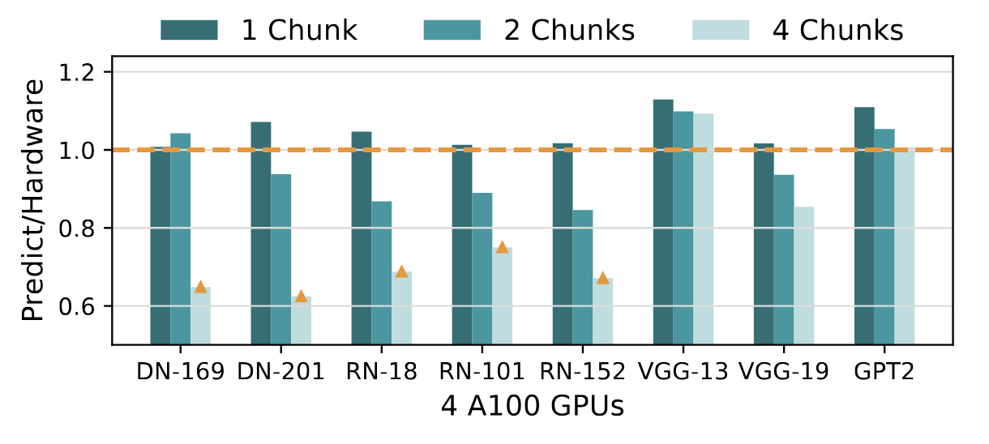
Validation Experiment
Pipeline parallelism
The prediction error comparing using TrioSim with applying pipeline parallelism on 4 A100 GPUs.
The average errors are 5.14%, 8.96%, and 8.18% for 1 chunk, 2 chunks, and 4 chunks, respectively.

Slide 43
The Use Cases of TrioSim

Slide 44
Moving Parts
Parallelism
Collective Comm
Task Scheduling
Memory Management
Network Topology
GPU Devices

Slide 45
Use Cases
Parallelism
What parallelism to use? How to organize multi-dimensional parallelism?
Collective Comm
Task Scheduling
Memory Management
Network Topology
GPU Devices

Slide 46
Use Cases
Parallelism
What parallelism to use? How to organize multi-dimensional parallelism?
Collective Comm
What communication scheme to use? Ring-based algorithm or tree-based algorithm?
Task Scheduling
Memory Management
Network Topology
GPU Devices

Slide 47
Use Cases
Parallelism
What parallelism to use? How to organize multi-dimensional parallelism?
Collective Comm
What communication scheme to use? Ring-based algorithm or tree-based algorithm?
Task Scheduling
How to schedule DNN layers? Which layer should execute on each GPU? SLO target?
Memory Management
Network Topology
GPU Devices

Slide 48
Use Cases
Parallelism
What parallelism to use? How to organize multi-dimensional parallelism?
Collective Comm
What communication scheme to use? Ring-based algorithm or tree-based algorithm?
Task Scheduling
How to schedule DNN layers? Which layer should execute on each GPU? SLO target?
Memory Management
How to organize memory? Shall we prefetch for future layers? Shall we rematerialize?
Memory Management
Network Topology
GPU Devices

Slide 49
Use Cases
Parallelism
What parallelism to use? How to organize multi-dimensional parallelism?
Collective Comm
What communication scheme to use? Ring-based algorithm or tree-based algorithm?
Task Scheduling
How to schedule DNN layers? Which layer should execute on each GPU? SLO target?
Memory Management
How to organize memory? Shall we prefetch for future layers? Shall we rematerialize?
Network Topology
What is the optimal hardware topology for a specific DNN? Can optical networks help?
Network Topology
GPU Devices

Slide 50
Use Cases
Parallelism
What parallelism to use? How to organize multi-dimensional parallelism?
Collective Comm
What communication scheme to use? Ring-based algorithm or tree-based algorithm?
Task Scheduling
How to schedule DNN layers? Which layer should execute on each GPU? SLO target?
Memory Management
How to organize memory? Shall we prefetch for future layers? Shall we rematerialize?
Network Topology
What is the optimal hardware topology for a specific DNN? Can optical networks help?
GPU Devices
Can lower-end devices achieve similar performance given a larger quantity?
GPU Devices

Slide 51
Use Cases
Parallelism
What TrioSim is NOT
Collective Comm
Architecture-level simulator (e.g., access remote memory within a kernel)
Simulator for under-utilized scenarios
Task Scheduling
Memory Management
Network Topology
GPU Devices

Slide 52
Summary
Lightweight: trace-based Flexible: flexible trace-extrapolator
Accurate: Less-than-simulator errors
TrioSim

Slide 53

TrioSim
Thank you!
Ying Li
Ph.D. Candidate
https://yingliphd.com
Scalable Architecture Lab

Slide 54
Backup Slides

Slide 55
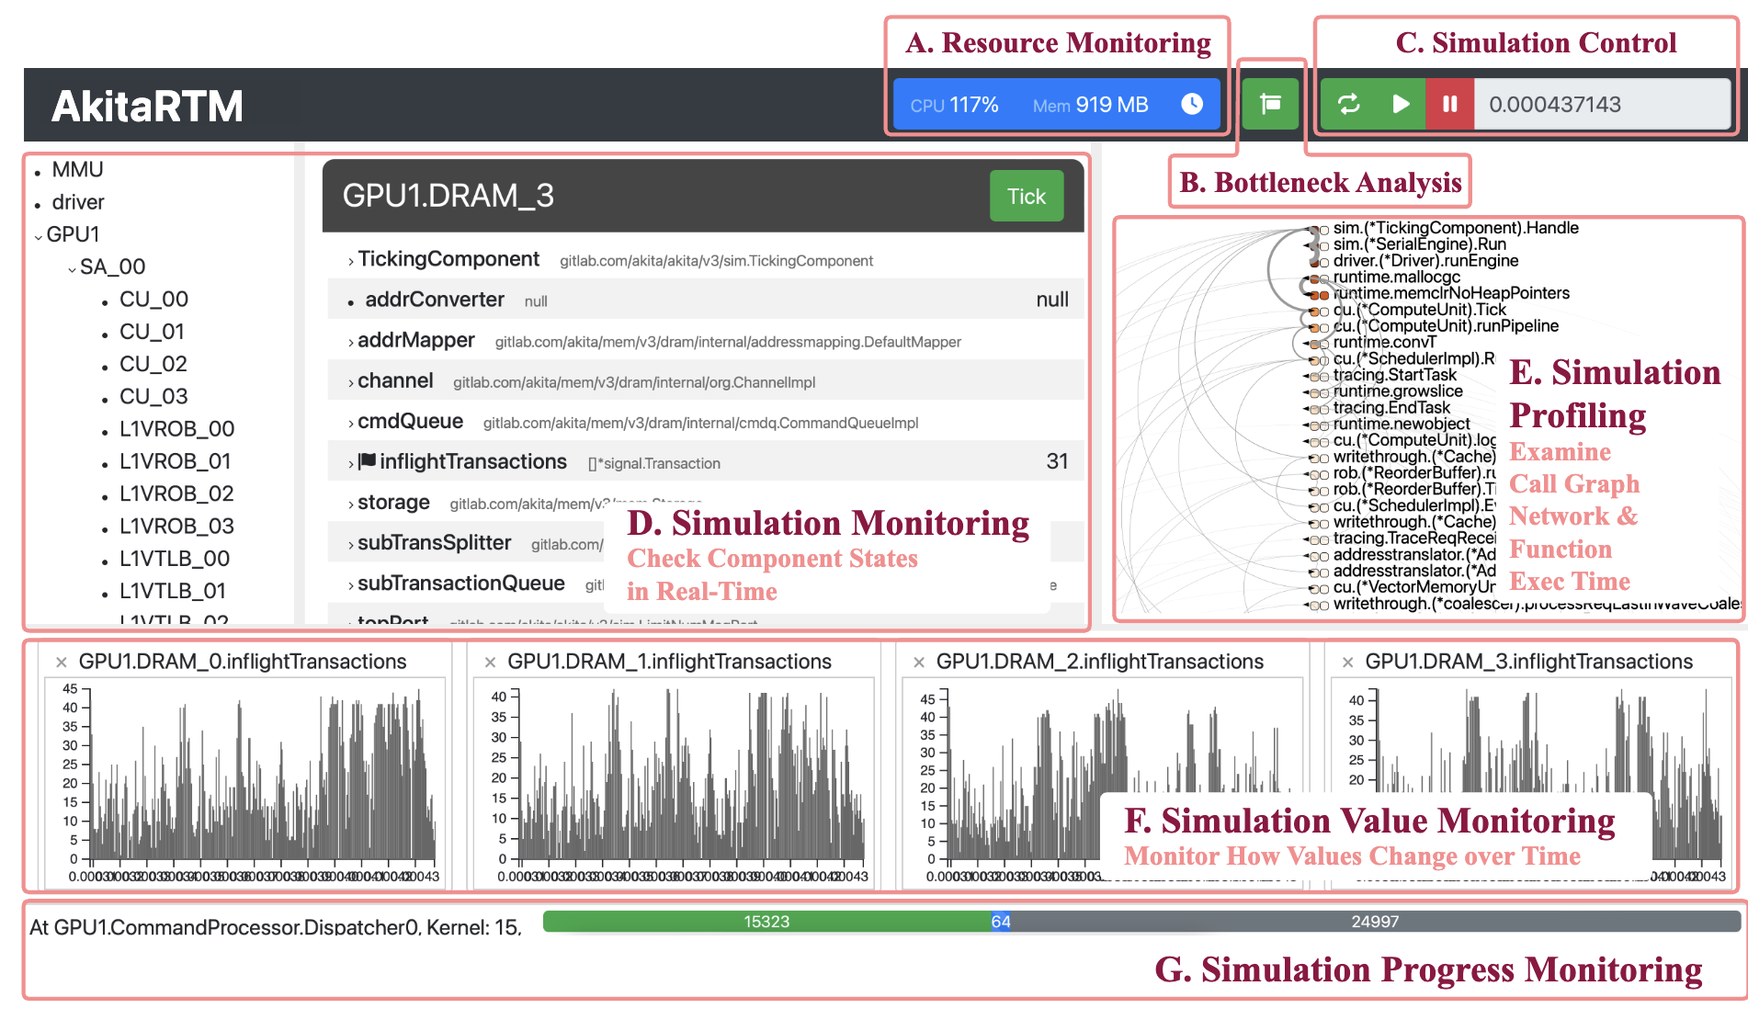
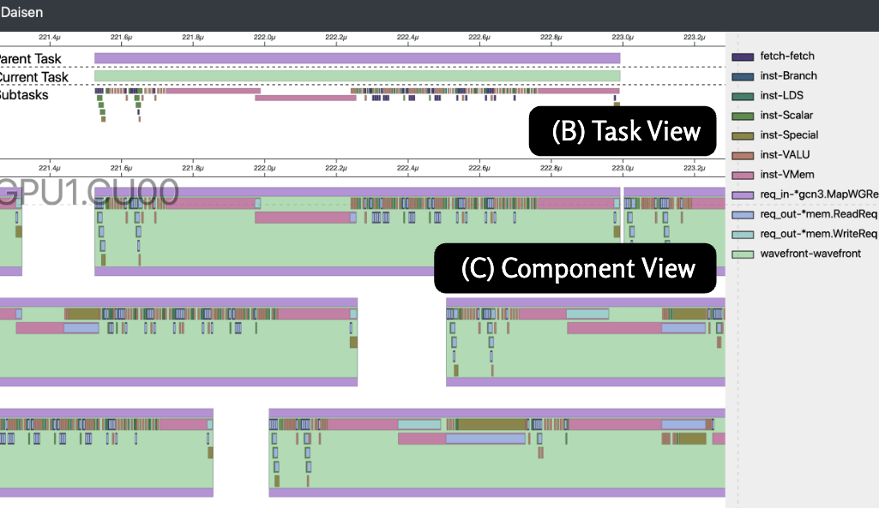
TrioSim Uniqueness
Similar Tools:
AstraSim – Well-rounded
DistSim – Hybrid-parallelism
vTrain – LLM
TrioSim Uniqueness:
Only require single-GPU traces
Good support for non-uniform network
Potential support for real-time monitoring and visualization
AkitaRTM: real-time monitoring tool for computer architecture simulators
Daisen: trace visualization tool for computer architecture simulators

Slide 56
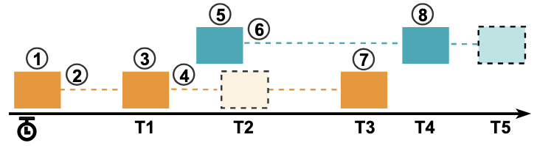
TrioSim
Case A: only one message in the link.
A new message comes.
Routing, bandwidth allocation, and scheduling an event at the time, T1.
3) No new message comes, the destination device receives the message at the time, T1.

Slide 57
TrioSim
Case B: two messages in the link.
4) Send the message to the destination. Routing, bandwidth allocation, and scheduling events at the time, T2.
5) A new message starts to transfer, and the current two messages share at least one link.
6) Recalculate the bandwidth and reschedule the delivery events of all the packets that are currently in transit at the time, T3 and T5 separately.
7) The destination receives the orange message at the time, T3. Because the orange message is received,
it recalculates the bandwidth and reschedules the delivery event for the blue message at the earlier time, T4.
8) The destination receives the message at the time, T4.

Slide 58
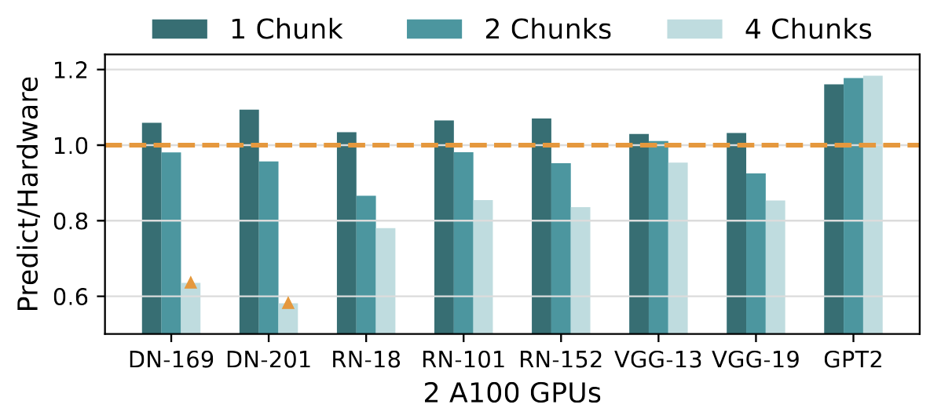
Experiment
Pipeline parallelism
The prediction error comparing using TrioSim with applying pipeline parallelism on 2 A100 GPUs .
The average errors are 6.82%, 6.58%, and 15.10% for 1 chunk, 2chunks, and 4 chunks, respectively.
Orange triangle: an abnormal value contrary to the theoretical expectation that execution times should decrease with more chunks.

Slide 59
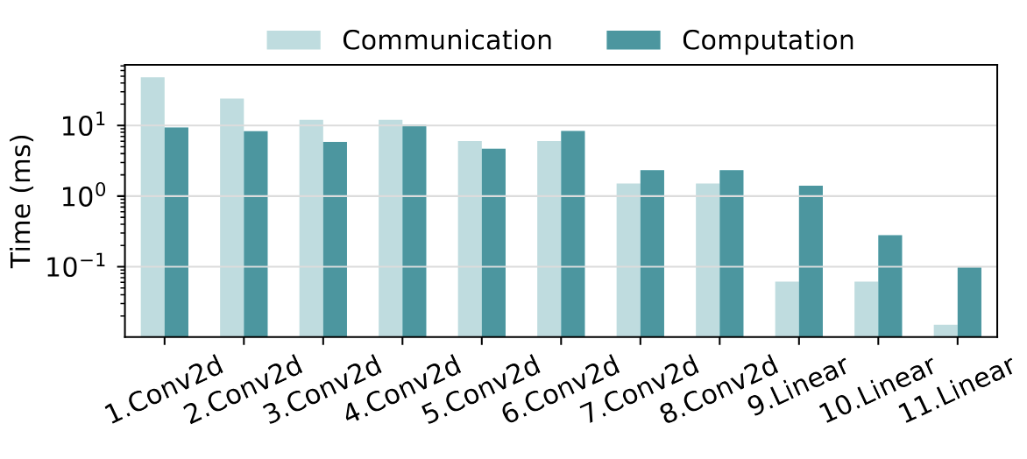
Experiment
Communication & computation time
Communication and computation times for all the ATen layers of Convolution and Linear operations during the forward stage of VGG-11 training by tensor parallelism on P1.

Slide 60
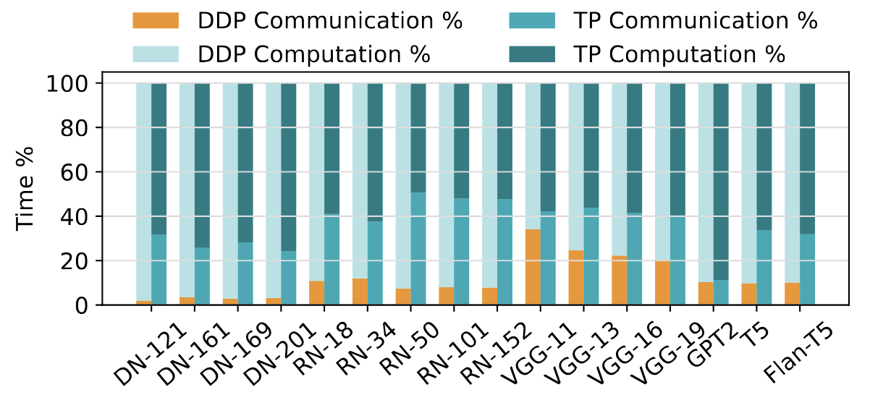
Experiment
Communication & computation time
Communication and computation time ratio for models training with tensor parallelism and data parallelism simulations on P1.

Slide 61
Experiment
New GPUs validation-----validate on P3, 8 H100 systems
Case 1 (cross-GPU prediction), input (1xA40 & 1xA100, BS128), output (8xH100, BS256);
traces from single A40 and A100 GPUs with a batch size of 128—
following Li’s model—to predict the performance on the 8 H100 system at batch size 256.
Case 2 (same-GPU prediction), input (1xH100, BS256), output (8xH100, BS256)
traces for a batch size of 256 on a single H100 GPU and use it as input of TrioSim to predict performance for the 8 H100 system.

Slide 62
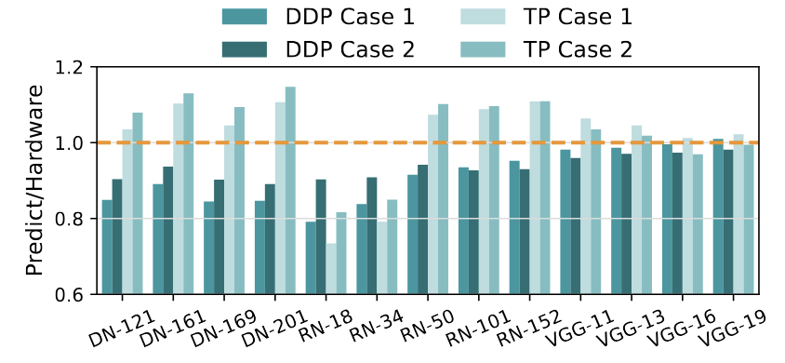
Experiment
New GPUs validation-----validate on P3, 8 H100 systems
Case 1 (cross-GPU prediction),
the average error is 9.09% for data parallelism, 9.07% for tensor parallelism
Case 2 (same-GPU prediction),
the average error is 6.69% for data parallelism, 9.09% for tensor parallelism

Slide 63
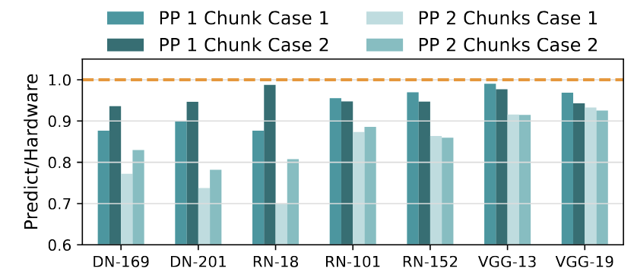
Experiment
New GPUs validation-----validate on P3, 8 H100 systems
Case 1 (cross-GPU prediction),
the average error is 5.65%, 16.28% for pipeline parallelism with 1, and 2 chunks, respectively.
Case 2 (same-GPU prediction),
the average error is 4.20%, 13.76% for pipeline parallelism with 1, and 2 chunks, respectively.

